Slide 1
Support Vector Machine
Understanding Support Vector Machines
From Intuition to Mathematical Formulation

Slide 2
In 1990s while neural networks were struggling due to computational limits, SVM became a very powerful alternative. It can handle both regression and classification problems for linear and nonlinear data. However it is most preferred for nonlinear classification problems.

Slide 3
Problem | Why Nonlinear
Fraud detection | irregular transaction patterns
Image recognition | complex pixel relationships
Medical diagnosis | nonlinear feature interactions
Handwritten digits | shape variations
Network security | irregular traffic patterns

Slide 4
Age vs Income → classify loan approval
young low income → reject
young high income → approve
middle age moderate income → approve
very old moderate income → reject
The boundary becomes curved, not straight.
SVM handles this naturally.
_______
/ \
/ Approve \
/ \
Reject Reject
Approve| Reject
----------|--------

Slide 5
Tumor classification (benign vs malignant)
Tumor radius
Texture
Smoothness
Area
Compactness
small tumors → benign
very large tumors → malignant
medium tumors with irregular texture → malignant
Boundary becomes nonlinear in feature space.

Slide 6
What Nonlinear Means Here
Nonlinear means the decision boundary is not: straight line
Instead it may be:
Circle, parabola, complex curve
Real problems where these patterns appear are:
Credit card fraud detection
Medical diagnosis
Handwriting recognition
Speech recognition
Image classification
That’s why SVM kernels became very popular.

Slide 7
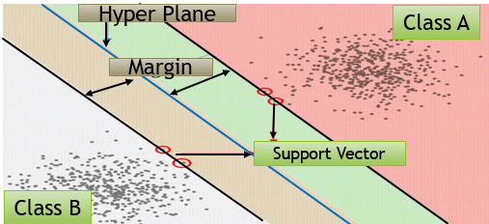
What is SVM?
Support Vector Machine, or SVM, is a supervised learning algorithm used for classification and regression tasks
Linear SVM (LinearSVC) → for linearly separable data
Kernel SVM (SVC) → for nonlinear data
Its primary goal is to find the optimal hyperplane that best separates data points belonging to different classes.

Slide 8
So if we are about to study for SVM. We need to understand, What is hyper plane? What is support vector? What is margin?

Slide 9
Hyperplane:
A hyperplane is a decision boundary that separates data points into different classes.
In a 2D space, it’s a line; in a 3D space, it’s a plane; and in higher dimensions, it’s a hyperplane.
A hyperplane is equidistant from the closest data points of both classes.
These closest points are called support vectors.

Slide 10
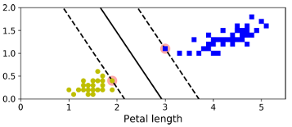
Solid line in the above plot represents the hyperplane of an SVM classifier.
This line not only separates the two classes but also stays as far away from the closest training instances as possible.

Slide 11
You can think of an SVM classifier as fitting the widest possible street (represented by the parallel dashed lines) between the classes. This is called large margin classification.
Here adding more training instances “off the street” will not affect the decision boundary at all.

Slide 12
Support Vectors:
Support vectors are the data points closest to the hyperplane.
These points determine the position and orientation of the hyperplane.

Slide 13
Margin:
The margin is the distance between the hyperplane and the nearest data points from each class.
Large Margin: Preferred as it implies better generalization. It is a good margin.
Small margin may lead to poor generalization.
Therefore, a larger margin is preferred.Hard Margin: Primal solution with linearly separable data.
Soft Margin: for non linearly separable data, allowing some misclassification.

Slide 14
If two classes can be separated by a straight line (or hyperplane), the data is linearly separable.
Similar to logistic regression, many lines or planes can separate the classes.
However, SVM selects the hyperplane that maximizes the margin.
But the plane that separate positive and negative point as wide as possible is the best line.

Slide 15
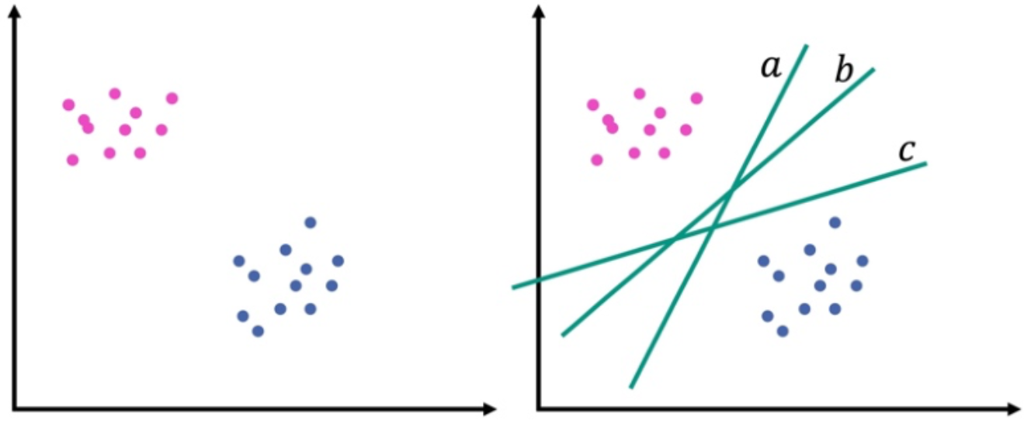
Many lines can separate the two classes. But not all of them generalize well to new data.
If many lines can separate the classes, SVM chooses the line that leaves the largest safety gap between the classes.

Slide 16
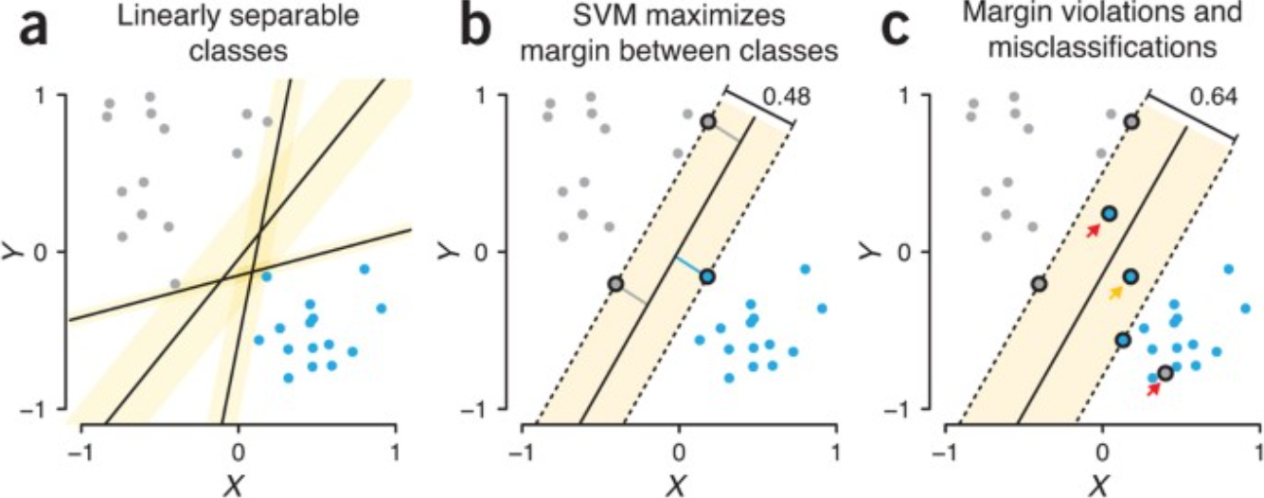

Slide 17
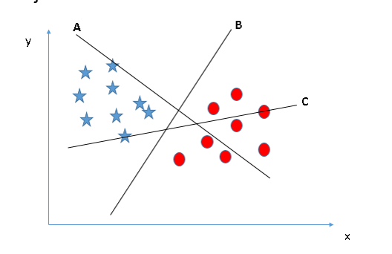
Now tell me which one is the best hyperplane here?

Slide 18
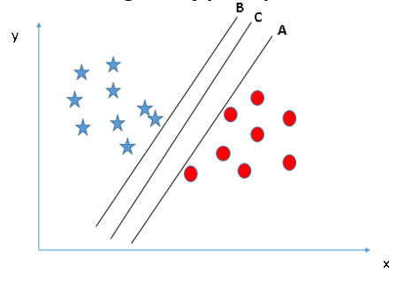
What about this?

Slide 19
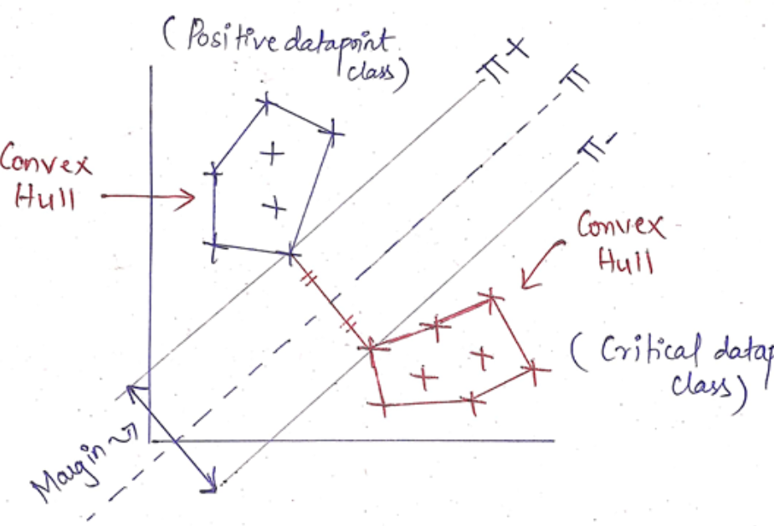
Convex Hull
The convex hull is the smallest convex polygon that contains all the points of that class.
If data is linearly separable: The two convex hulls do not intersect.
Find the shortest line segment connecting the two hulls.
This line segment connects two boundary points. Those boundary points are support vectors
Take that shortest line segment, Draw a plane that bisects it perpendicularly
That plane is: Maximum Margin Hyperplane

Slide 20
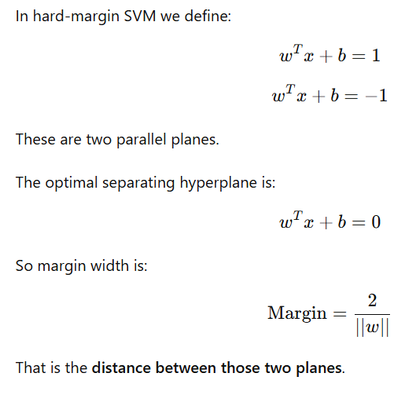
What is margin width(λ) ?

Slide 21
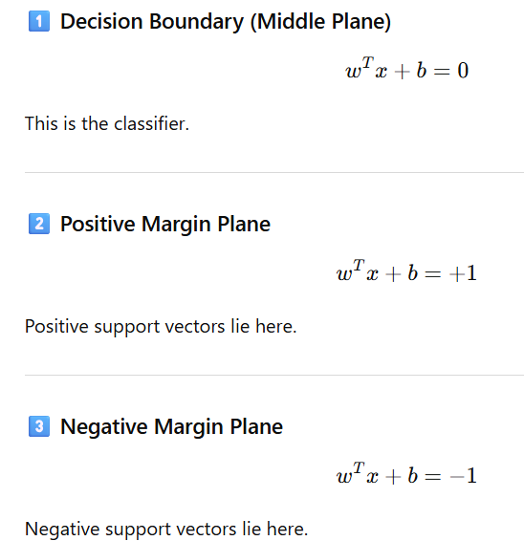
SVM actually defines three parallel planes.

Slide 22
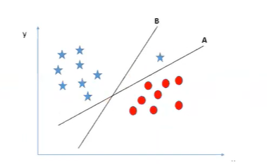
Which one is better?

Slide 23
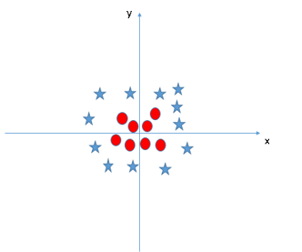
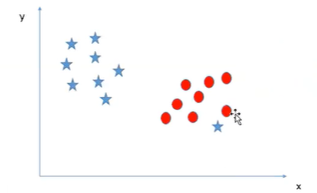
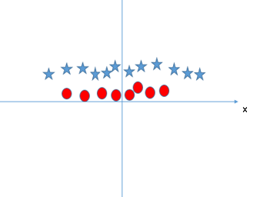
But the challenge starts here

Slide 24

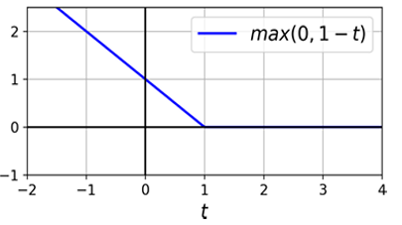
Hinge Loss:
It is a loss function used in Support Vector Machines (SVMs) for binary classification tasks. It helps in maximizing the margin between classes, ensuring robust separation of data points.
Hinge loss penalizes points inside the margin or misclassified, but ignores those safely outside.
L(t)=max(0,1−t)

Slide 25
What is t ?
t = y⋅f(x)
It is called the margin value.
It measures how correct the prediction is, not what the class is.
Where y is the true class label.
For SVM: y ∈ {−1,+1}
f(x)=w.x+b-->.It is the model score, not the class.
Predicted class is:
y^ = sign(f(x))
So: If f(x) > 0 → +1,
If f(x) < 0 → −1

Slide 26
So hinge loss depends on: yf(x) which measures how correct the prediction is.
Value of t | Meaning | Loss
( t > 1 ) | Correct | 0 and outside margin
( 0 < t < 1 ) | Correct | >0 but inside margin
( t < 0 ) | Misclassified | large

Slide 27
Model | Loss Function | Objective
Linear Regression | Squared Loss | Minimize error
Logistic Regression | Log Loss | Maximize likelihood
Support Vector Machine | Hinge Loss | Maximize margin
Linear Regression: Loss = (y − ŷ)² + Regularization
Logistic Regression: Loss = log(1 + e^(−y f(x))) + Regularization
SVM: Loss = max(0 , 1 − y f(x)) + Regularization

Slide 28
How SVM Works?
Finding the Hyperplane:
Maximizes the margin between different classes.
Uses support vectors to determine the decision boundary.
Decision Boundary:
Separates positive and negative classes as widely as possible.

Slide 29

Linearly separable data

Slide 30
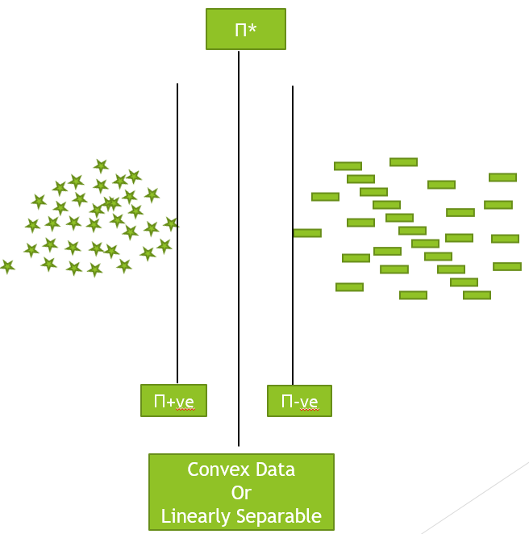
In case of linearly separable data we can draw thousands of line between two classes and looking for a line which at equidistant from two classes which is called hyperplane.

Slide 31
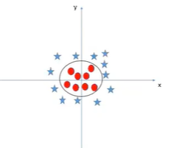
If data is not linearly separable in the original feature space,
we use kernel methods to make it linearly separable in a higher-dimensional space.
Kernel lifts data so straight line works

Slide 32
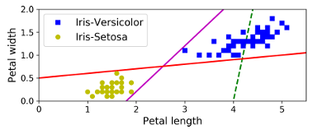
The plot shows the decision boundaries of three possible linear classifiers.
The model with decision boundary by the dashed line can not separate the classes properly.
The other two models work perfectly, but their decision boundaries come so close to the instances that makes them difficult to perform well on new instances.

Slide 33
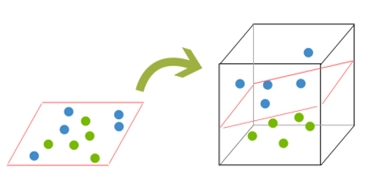
2d to 3d

Slide 34
Step 1: Original 2D Data (Not Linearly Separable)
Point | x₁ | x₂ | Class
A | 1 | 0 | +1
B | 0 | 1 | +1
C | -1 | 0 | +1
D | 0 | -1 | +1
E | 0 | 0 | -1
No straight line can separate center from all outer points.

Slide 35
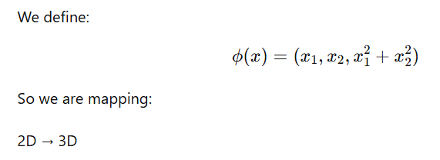
Step 2:Define Feature Transformation

Slide 36
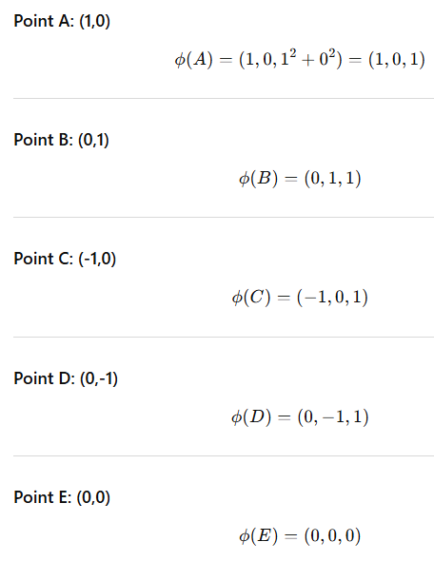
Step 3: Apply Transformation

Slide 37
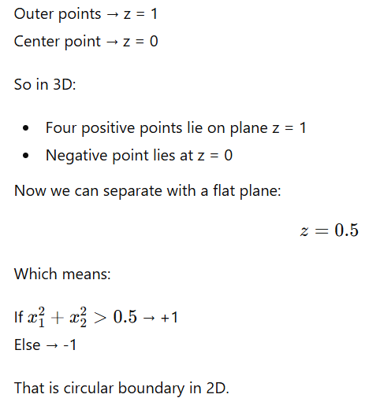
Step 4: Look at New Coordinates

Slide 38
So nonlinear in 2D becomes linear in 3D.
Feature mapping lifts data into higher dimension where a simple linear separator becomes possible.

Slide 39
Kernel
In SVM, we always try to find a linear hyperplane that separates classes.
But sometimes data is not linearly separable in the original feature space.
Then SVM uses a technique called the Kernel Trick.
A kernel function:
Takes low-dimensional input space
Implicitly maps it to a higher-dimensional space
Makes non-separable data linearly separable
Then SVM finds a linear hyperplane in that higher space.

Slide 40
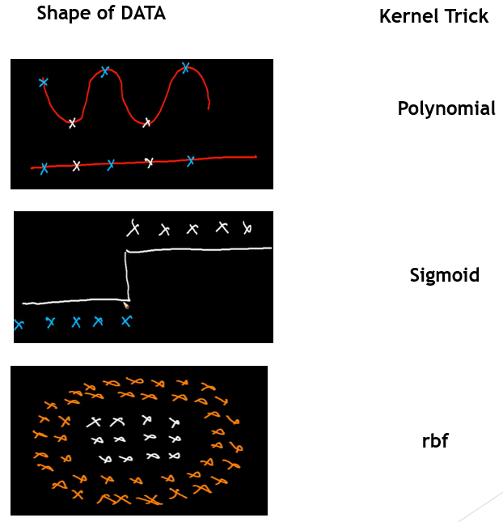
Common kernel Tricks

Slide 41

Kernel = Polynomial
But in case of non linearly separable data it is not simple to draw hyperplane and polynomial kernel come into picture.
Polynomial kernel creates polynomial decision boundary, means where we are increasing the magnitude of each point polynomially.

Slide 42
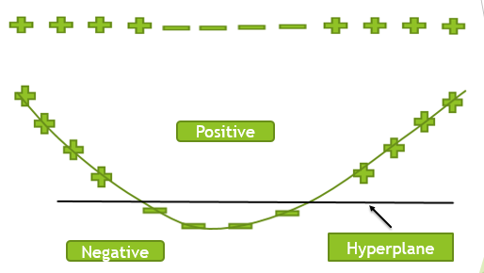
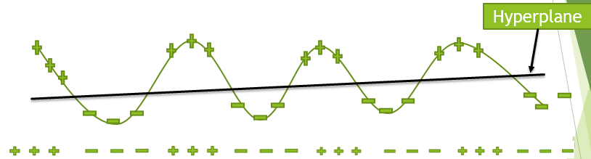

Slide 43
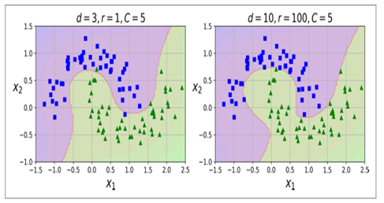

Slide 44
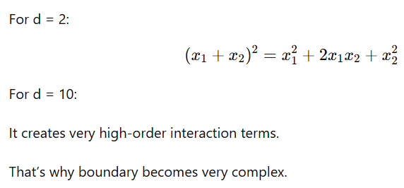
Polynomial kernel expands

Slide 45
Parameter | Meaning | Effect
d | Polynomial degree | Controls boundary complexity
r | Bias term (coef0) | Controls influence of lower-order terms
C | Regularization | Controls overfitting vs margin

Slide 46


Kernel = RBF Radial Basis Function
It measures similarity between two points.
‖x − y‖² = squared Euclidean distance between x and y
If two points are: Very close → distance small
Far apart → distance large
Then:
If distance small: K(x, y)≈1 → Very similar
If distance large: K(x,y)≈0 → very different

Slide 47
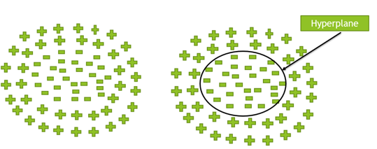
Why “Radial”?
Because similarity depends only on distance.
It forms circular (radial) influence around each point.
Instead of drawing straight line: RBF allows curved boundary.
What Is γ (Gamma)?
Controls how far influence of a point spreads.

Slide 48
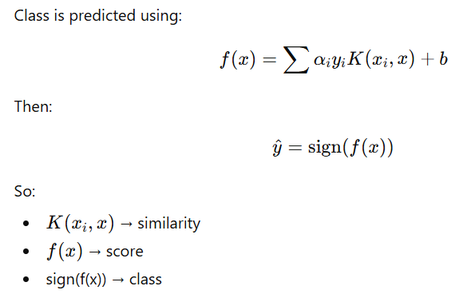

Slide 49
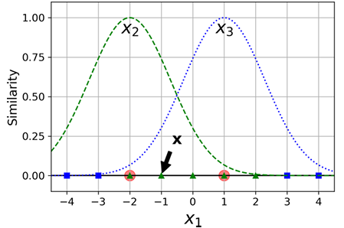
Example:
let’s take the one-dimensional dataset ,add two landmarks to it at x1 = –2 and x1 = 1 (see the plot).
Next, let’s define the similarity function to be the Gaussian Radial Basis Function (RBF) with γ = 0.3 .

Slide 50
It is a bell-shaped function varying from 0 (very far away from the landmark) to 1 (at the landmark).
To compute the new features. For example, let’s look at the instance
x1 = –1:
it is located at a distance of 1 from the first landmark, and 2 from the second landmark.
Therefore its new features are :
x₂ = exp(−0.3 × 1²) ≈ 0.74
x₃ = exp(−0.3 × 2²) ≈ 0.30.

Slide 51
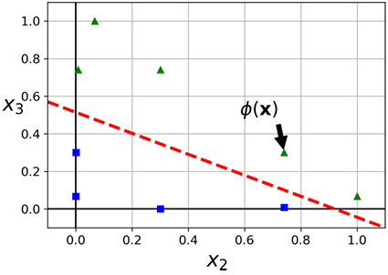
The plot shows the trans formed dataset (dropping the original features).
Now linearly separable.

Slide 52
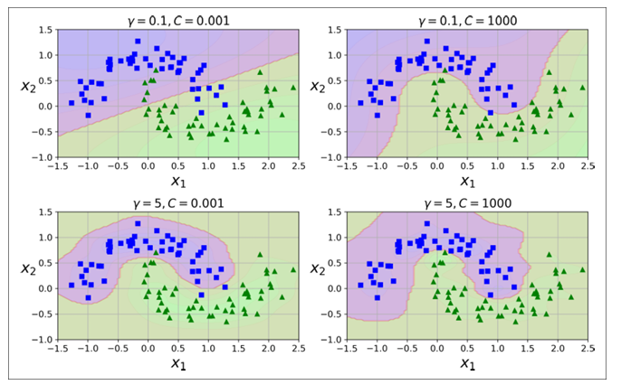

Slide 53
The plots show models trained with different values of hyper parameters gamma (γ) and C.
The plots show that increasing gamma makes the bell-shape curve narrower, and as a result each instance’s range of influence is smaller.
Conversely, a small gamma value makes the bell-shaped curve wider, so instances have a larger range of influence.
So γ acts like a regularization hyperparameter: if your model is overfitting, you should reduce it, and if it is under fitting, you should increase it.

Slide 54
This balance is crucial because it determines whether the SVM will fit the training data too closely (overfitting) or be too general (underfitting).
High gamma: Model is sensitive to training data, potentially overfitting.
Low gamma: Model is smoother and more generalized, potentially underfitting.

Slide 55

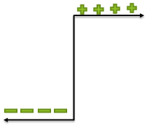
Kernel = Sigmoid

Slide 56
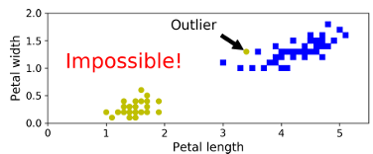
Hard Margin limitation
If we strictly impose that all instances be ‘off the street’ and on the right side, this is called hard margin classification.
There are two main issues with hard margin classification.
First, it only works if the data is linearly separable, and
Second it is quite sensitive to outliers.
Just one additional outlier: it is impossible to find a hard margin.

Slide 57
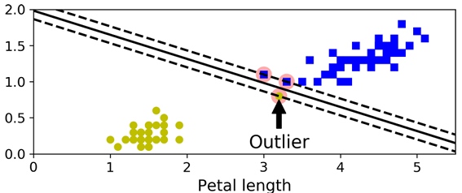
While the decision boundary ends up very different without the outlier.

Slide 58
To avoid these issues it is preferable to use a more flexible model.
The objective is to find a good balance between keeping the street as large as possible and limiting the margin violations (i.e., instances that end up in the middle of the street or even on the wrong side).
This is called soft margin classification.
This balance can be controlled using the C hyper parameter:

Slide 59

Hard margin linear SVM classifier objective

Slide 60

Soft margin linear SVM classifier
To get the soft margin objective, we need to introduce a slack variable ζ(i) ≥ 0 for each instance:
ζ(i) measures how much the ith instance is allowed to violate the margin.
We now have two conflicting objectives:
making the slack variables as small as possible to reduce the margin violations,
and making as small as possible to increase the margin.
This is where the C hyper parameter comes in:
it allows us to define the tradeoff between these two objectives.

Slide 61
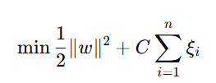
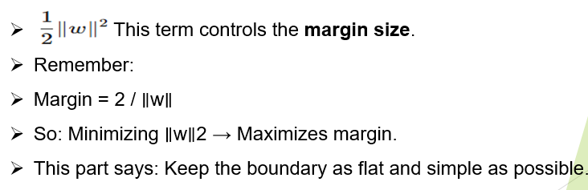
Soft Margin SVM objective function.

Slide 62
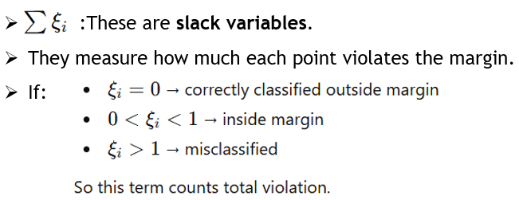

Slide 63
C is the regularization parameter
It controls trade-off:
Small C → ignore violations → wider margin Large C → punish violations → narrower margin
So:
C balances: Margin size vs Misclassification penalty

Slide 64
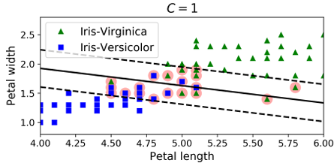
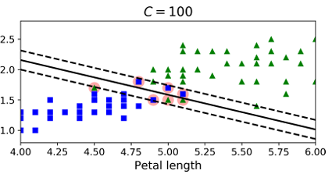

Slide 65
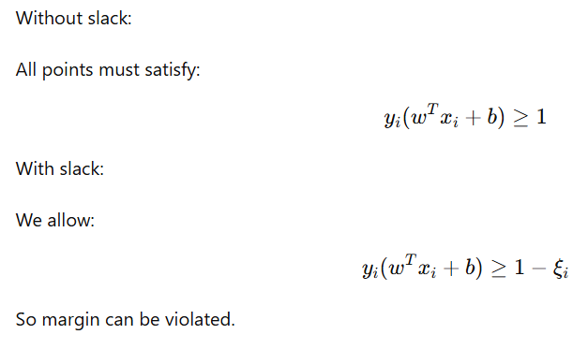
Geometric Interpretation

Slide 66
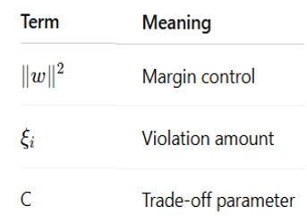
Soft-margin SVM minimizes model complexity while penalizing classification errors.

Slide 67
Primal Form of SVM
Many hyperplanes can separate the positive and negative.
SVM chooses the hyperplane with the maximum margin.
Also called decision boundary.

Slide 68
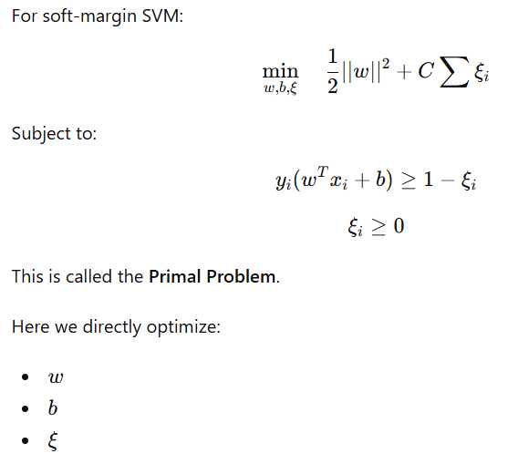

Slide 69
Why Dual Form?
We introduce the dual form because it allows us to use the kernel trick, which is difficult to apply directly in the primal formulation.
In the dual formulation, the optimization depends only on dot products between data points.
These dot products can be replaced by a kernel function.

Slide 70
The primal SVM works directly with the feature vectors, but the dual SVM depends only on dot products between training samples.
This allows us to replace the dot product with a kernel function and implicitly map data into a higher dimensional space.
Dual Form converts constrained problem into α optimization.
Decision boundary depends only on training samples

Slide 71
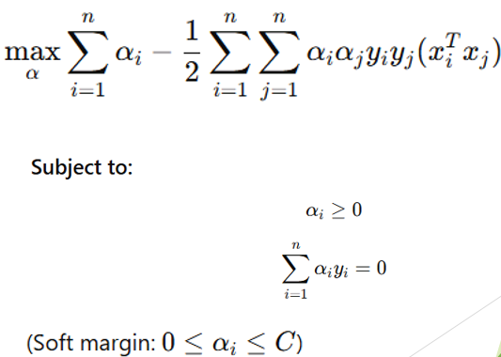
Dual Optimization Problem

Slide 72
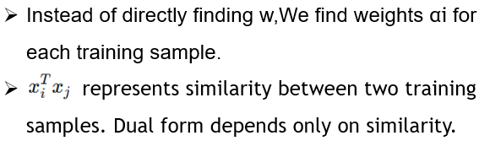
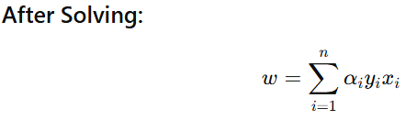
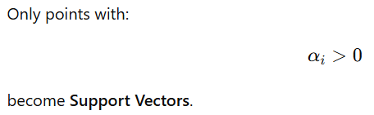

Slide 73
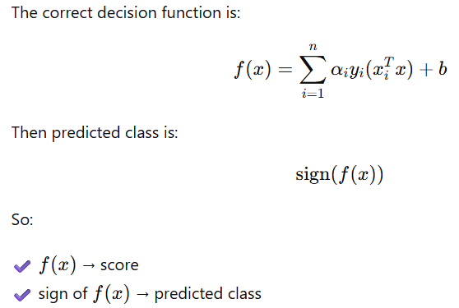
The Real Prediction Formula?

Slide 74
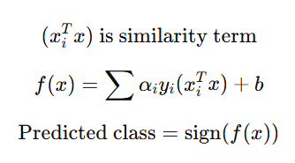

Slide 75
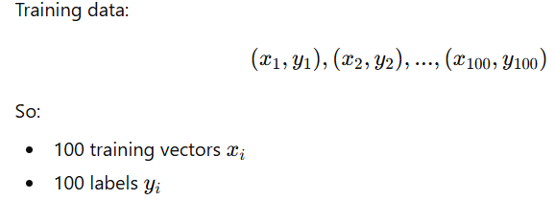
Let us assume we have 100 Observations

Slide 76
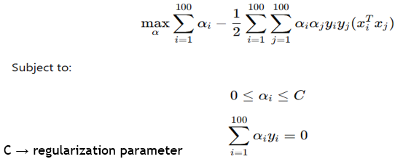

Each αi​ tells how important that training point is in defining the decision boundary.

Slide 77

What Does α Represent Here?

Slide 78

Example With 100 Observations

Slide 79


Because the dual objective considers pairwise interactions between training samples. The term means: interaction between sample i and sample j.
So the algorithm checks:
how similar two points are?
how their classes relate?

Slide 80
What do i and j mean?
They are just indices.
Example if dataset has 3 samples:
(x1​,y1​),(x2​,y2​),(x3​,y3​).
Then the double summation evaluates:
(i=1,j=1) (i=1,j=2)(i=1,j=3)
(i=2,j=1)(i=2,j=2)(i=2,j=3)
(i=3,j=1)(i=3,j=2)(i=3,j=3)

Slide 81

Example with 3 samples
Dual SVM is computes how every training sample interacts with every other sample.
That’s why we see the double summation:
∑ i
∑ j

Slide 82



Slide 83
Symbol | Meaning
(x_1) | feature vector of sample 1
(y_1) | class label of sample 1
(x_1^T x_1) | similarity of sample with itself
α_1) | weight assigned to sample 1

Slide 84



Slide 85
Problem: Titanic Survival
We use only Age as feature.
Label:
Survived → +1
Not Survived → −1
Training Data: In table each one is training point(xi)
Passenger | Age | Survived (y)
P1 | 10 | +1
P2 | 18 | +1
P3 | 25 | -1
P4 | 40 | -1

Slide 86

Step 1: Assume SVM Finds Boundary at Age = 21

Slide 87


Step 2: Check Margin Condition

Slide 88



Slide 89

Who Becomes Support Vector?
The closest opposite-class points:
Age 18 (+1) Age 25 (−1)

Slide 90

These define margin.

Slide 91

Step 3: Dual View

Slide 92
Interpretation
Instead of drawing line directly,
Dual says:
Compare new passenger with important passengers (18 and 25).
If more similar to 18 → survived If more similar to 25 → not survived

Slide 93
Important Observations
α never negative
Only borderline passengers get α > 0
Far passengers get α = 0
Misclassification depends on margin condition, not α sign

Slide 94
Support vectors = passengers closest to decision boundary.
They alone define survival rule.
Condition | Meaning
αᵢ = 0 | Not support vector, far from boundary
0 < αᵢ < C | On margin
αᵢ = C | Inside margin or misclassified
αᵢ < 0 | Impossible

Slide 95

SVM and Feature scaling
SVMs are sensitive to the feature scales, as in Figure on the left plot, the vertical scale is much larger than the horizontal scale, so the widest possible street is close to horizontal.
After feature scaling, the decision boundary looks much better (on the right plot).

Slide 96
Applications
Content: SVM finds applications across various domains:
Image Classification: Identifying objects and patterns in images.
Text Classification: Categorizing documents based on their content.
Bioinformatics: Analyzing genetic data for disease diagnosis.
Finance: Predicting stock market trends and fraud detection.
Medicine: Diagnosing diseases based on medical data.

Slide 97


Slide 98
Key Points for SVM
Outlier Handling:
If outliers are present, handle them appropriately as they can significantly affect the SVM model's performance.
Overfitting and Under fitting:
Overfitting: Reduce C
Under fitting: Increase C
3. Hyper parameter Tuning: Grid Search or Randomized Search
C (Regularization parameter)
Kernel type
Gamma (for RBF kernel)

Slide 99
4.High-Dimensional Data:
SVM performs well in high-dimensional spaces, making it a good choice for datasets with many features.
SVM works very well when features are large (p >> n).
5.Kernel Selection: Choosing the right kernel is crucial for model performance:
Linear Kernel: Suitable for linearly separable data.
Polynomial Kernel: For data with polynomial relationships.
RBF Kernel (Radial Basis Function): For non-linear data.
Sigmoid Kernel: Rarely used; logistic regression is preferred for sigmoid-shaped data.
6. Observation vs. Variables:
SVM can handle high-dimensional data well.
However, training becomes expensive when the dataset size is extremely large.

Slide 100
7. Feature Scaling:
Always perform feature scaling (e.g., StandardScaler or MinMaxScaler) before training an SVM model. SVM is sensitive to the scale of the features.
8. Decision Surface:
SVM creates a decision boundary (or surface) that separates different classes. The margin is maximized between the closest points of different classes (support vectors).
9. Nonlinear Problems:
Linear SVM handles linearly separable data. Kernel SVM extends SVM to non-linear problems..
10. Feature Importance:
While SVM doesn't directly provide feature importance scores, techniques like Recursive Feature Elimination (RFE) can be used to identify important features.

